Slide 1

CUSTOMER REVIEW ANALYSIS
Present By Levy - DAk4

Slide 2

Introduction
Method
Data Preprocessing
Result
CONTENT
Data Modeling
Positive/Negative Analysis
EDA
Conclusion
2

Slide 3
INTRODUCTION
Objective: Mine Amazon reviews for actionable insights.
Approach: Use NLP techniques to process and analyze textual feedback.
Key Goals: Highlight product pros & cons from authentic user voices.
Outcome: Data-driven recommendations to enhance product and service offerings.
3

Slide 4
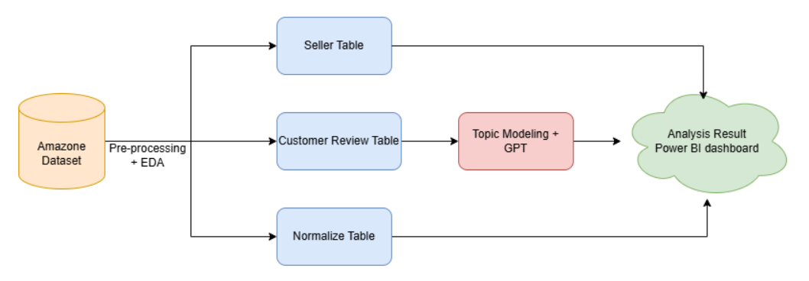
INTRODUCTION
4

Slide 5
DATA REPROCESSING
Check for Duplicates and Remove Redundant Data Rows
Handle Missing Values and Process Each Row Individually
Generate Three Data Files with Dictionaries Based on Links:
normalized_data.csv: 10,000 rows, 21 columns
seller.csv: 31,579 rows, 3 columns
customer_review.csv: 29,530 rows, 7 columns
Data dictionary is managed and stored on Datahub.
5

Slide 6
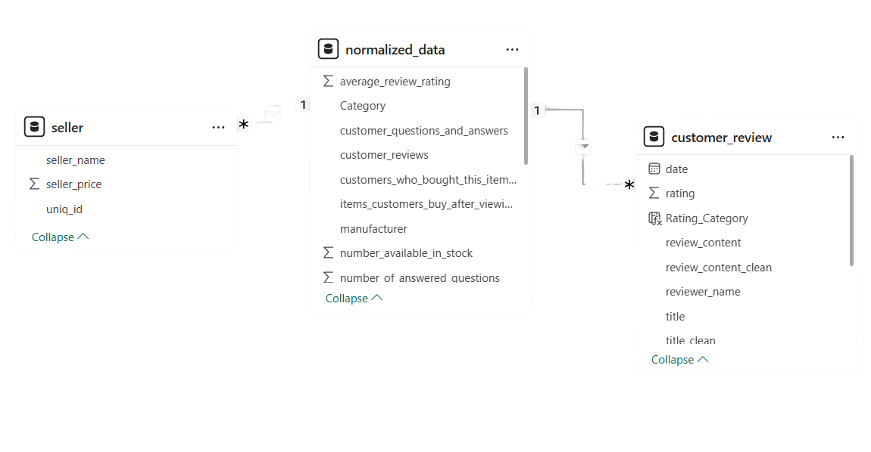
DATA MODELING
6

Slide 7
EDA
Univariate analysis
Analysis of variables by index
Multivariate analysis
7

Slide 8
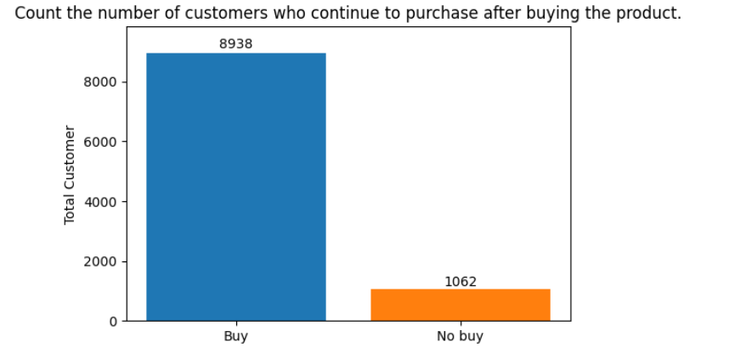
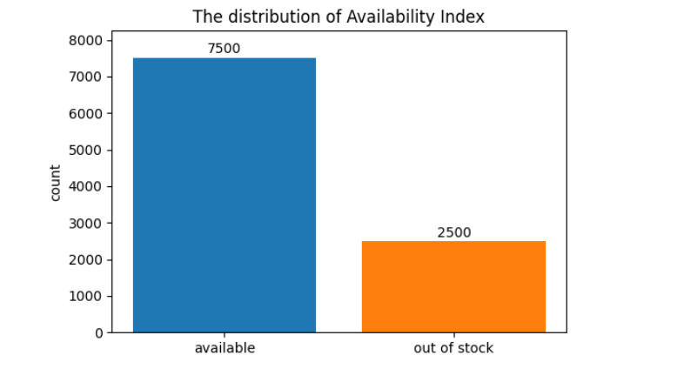
EDA
Retention rate: 89%
In-Stock rate: 75%
8

Slide 9
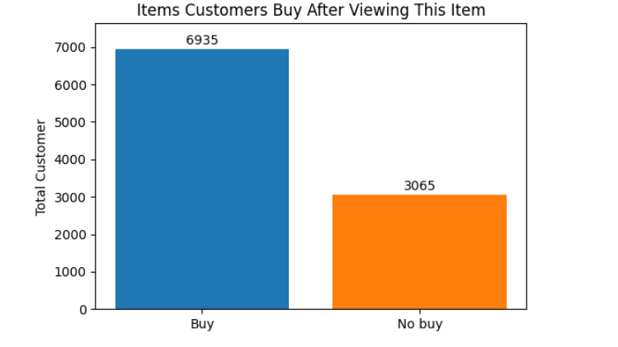
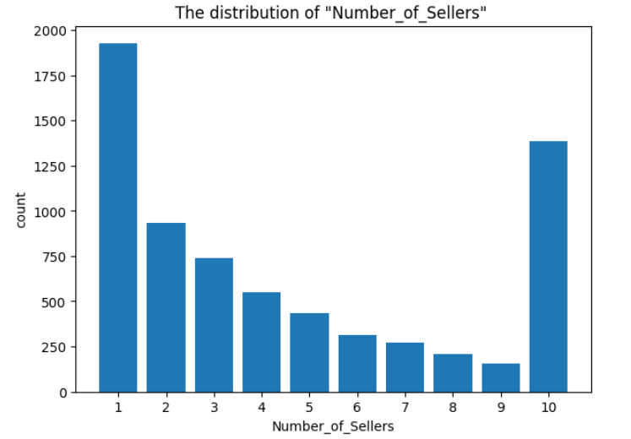
EDA
9

Slide 10
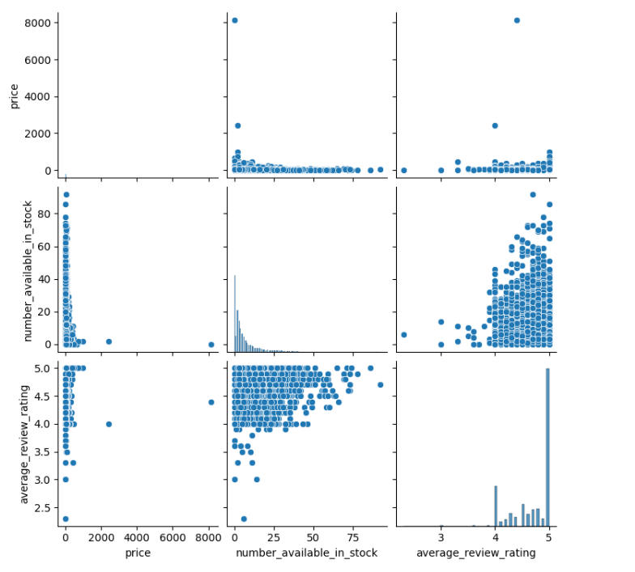
EDA
10

Slide 11
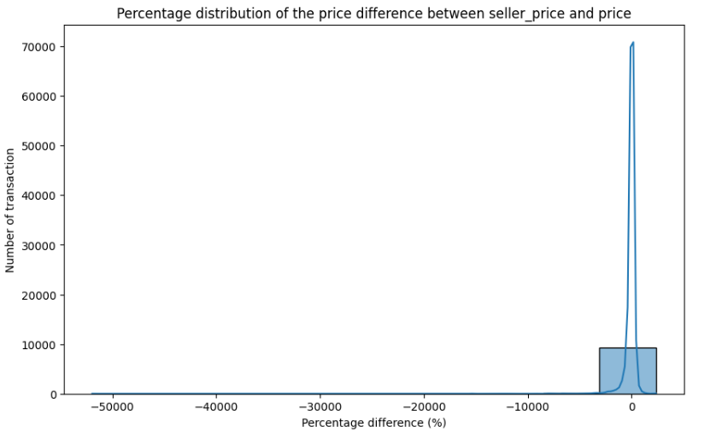
EDA
11

Slide 12
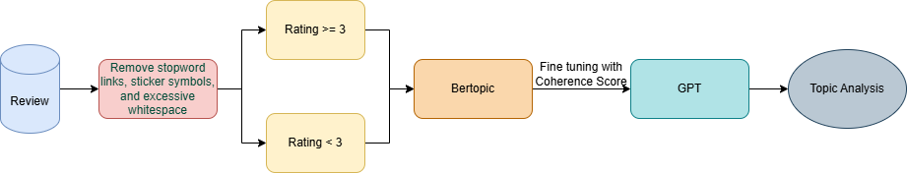
METHOD
12

Slide 13
RESULT
Positive topic (link) | Positive topic (link)
k | Mean topic coherence (c_v)
5 | 0.507
10 | 0.412
15 | 0.340
20 | 0.383
25 | 0.419
Negative topic (link) | Negative topic (link)
k | Mean topic coherence (c_v)
2 | 0.404
3 | 0.441
4 | 0.5
5 | 0.471
10 | 0.46
15 | 0.421
13

Slide 14
POSITIVE ANALYSIS
Topic 0: The joy and quality of entertainment products.
Topic 1: High satisfaction with perfect products.
Topic 2: Device battery/charging performance.
Topic 3: Technical difficulties when watching online videos.
14

Slide 15
NEGATIVE ANALYSIS
Topic 0: Focuses on the inconsistency between expectations (based on advertisements) and the actual quality of the product.
Topic 1: Criticizes specific technical issues with Thomas Trackmaster train toys, particularly their incompatibility with older tracks.
Topic 2: Addresses entertainment products like inflatable pools and play sand that have manufacturing defects or do not match descriptions, causing inconvenience to users.
15

Slide 16
CONCLUSION
Recommendation:
Standardization and initial vetting of seller listings
A‑to‑Z Guarantee policy and expedited refunds
Strict enforcement measures against non‑compliant sellers
Seller training and support: providing guidelines for writing accurate product descriptions and proper photography, plus regular workshops and webinars to enhance policy compliance
16

Slide 17
THANK YOU
17

